Slide 1

NFL Home-Field Advantage in the Mahomes Era
Evidence from Game Outcomes, 2018–Present
BUS 446 – Final Project
Group Members: Vitor, Rodrigo, Connor, Madhia

Slide 2
Table of Contents
Understanding Home-Field Advantage
Data & Method
Key Results & Visualizations
Business Insights & Recommendations
GitHub Project Structure & Next Steps

Slide 3
Understanding Home-Field Advantage
Home-field advantage means teams perform better at home than away.
Possible drivers: fan support, travel fatigue, stadium familiarity, referee bias.
In the NFL this affects team strategy, playoff seeding, and betting markets.
We focus on whether this advantage still exists in the modern NFL (2018–present).

Slide 4
Why This Matters for Business
Teams: Plan travel, rest, and game strategy differently for home vs. away.
League: Schedule games and design rules to keep competition fair and exciting.
Sportsbooks & Bettors: Set and evaluate betting lines that include home-field effects.
Analytics & Data Roles: Use real game data for predictive models and decision making.

Slide 5

Research Questions
1. What is the overall magnitude of home-field advantage from 2018–present, using home win percentage and average score differential, compared to a 50% win baseline and 0-point average score difference?
2. How has home-field advantage changed over time, especially before, during, and after the COVID-affected 2020 season?
3. Does home-field advantage differ between regular season and playoff games, and do certain teams show especially strong or weak home performance?

Slide 6
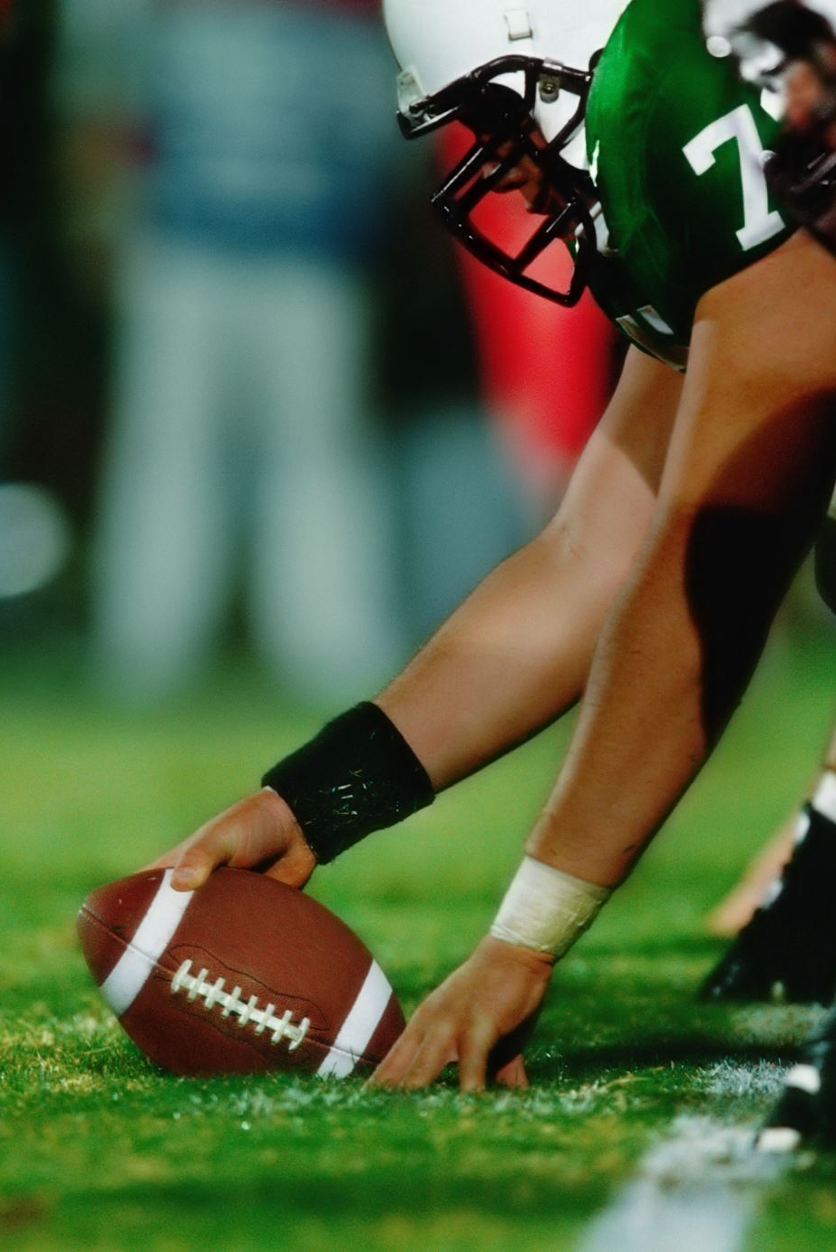
Dataset: NFL Game Outcomes (2018–Present)
Source: SCORE Sports Data Repository – “National Football League Game Outcomes”.
Coverage: all regular season and playoff games from the 2018 season onward.
Observations: 1,657 games, each row represents a single game.
Focus: recent “Mahomes era”, reflecting modern NFL style and rules.

Slide 7
Key Variables
season – season year (2018, 2019, …).
game_id – unique identifier for each game.
game_type – REG (regular), WC, DIV, CON, SB (playoffs).
week – week number (regular and into playoffs).
home_team, away_team – team abbreviations.
home_score, away_score – final points scored.
game_outcome – from home perspective (1 = home win, 0 = away win, 0.5 = tie).
score_diff – home_score minus away_score (positive = home scored more).

Slide 8
Data Limitations & Context
Time period limited to 2018–present; does not cover older NFL eras.
Only game-level outcomes; no player stats, betting lines, travel distance, or weather.
Some franchise naming changes (e.g., Raiders as OAK vs LV) require simple cleaning.
League-wide context (rule changes, COVID-19) may influence results but is not coded.
Dataset is still ideal for win percentage and score differential analysis.

Slide 9
Methodology
Filter data to all games from 2018 through the latest available season.
1
Construct two main measures: home win percentage and average score differential.
2
Compute results overall, by season, by game type (regular vs playoffs), and by team.
3
Compare results to baselines: 50% win rate and 0-point score differential.
4

Slide 10

Statistical Approach
Descriptive statistics for home win rate and score_diff.
Optional inference: test if home win rate > 50% (proportion test).
Optional inference: test if mean score_diff > 0 (one-sample t-test).
Use Excel, R, or Python to compute results and build the charts shown in this deck.

Slide 11
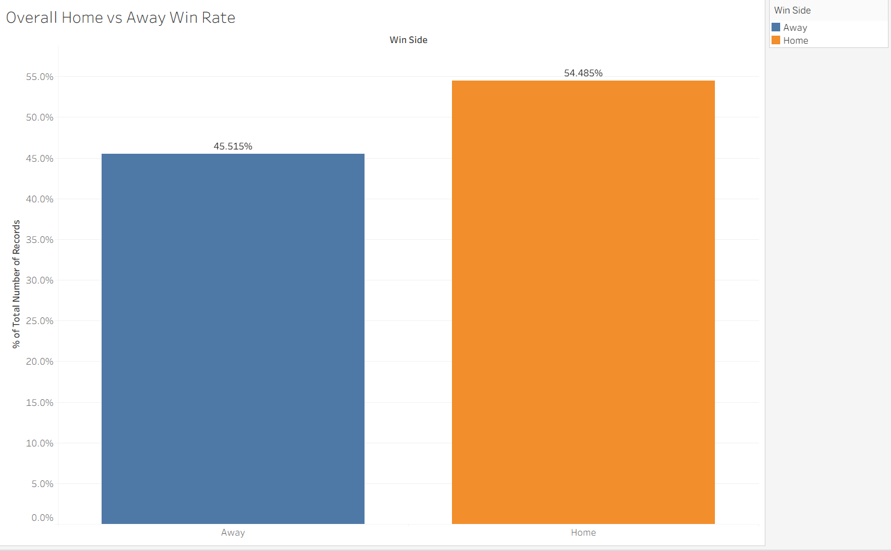
Overall Home vs Away Win Rate
The chart compares overall win rates by location and shows that home teams win about 54.5% of games, while away teams win about 45.5%.
This roughly 9 percentage point gap suggests a clear home-field advantage in the dataset.

Slide 12
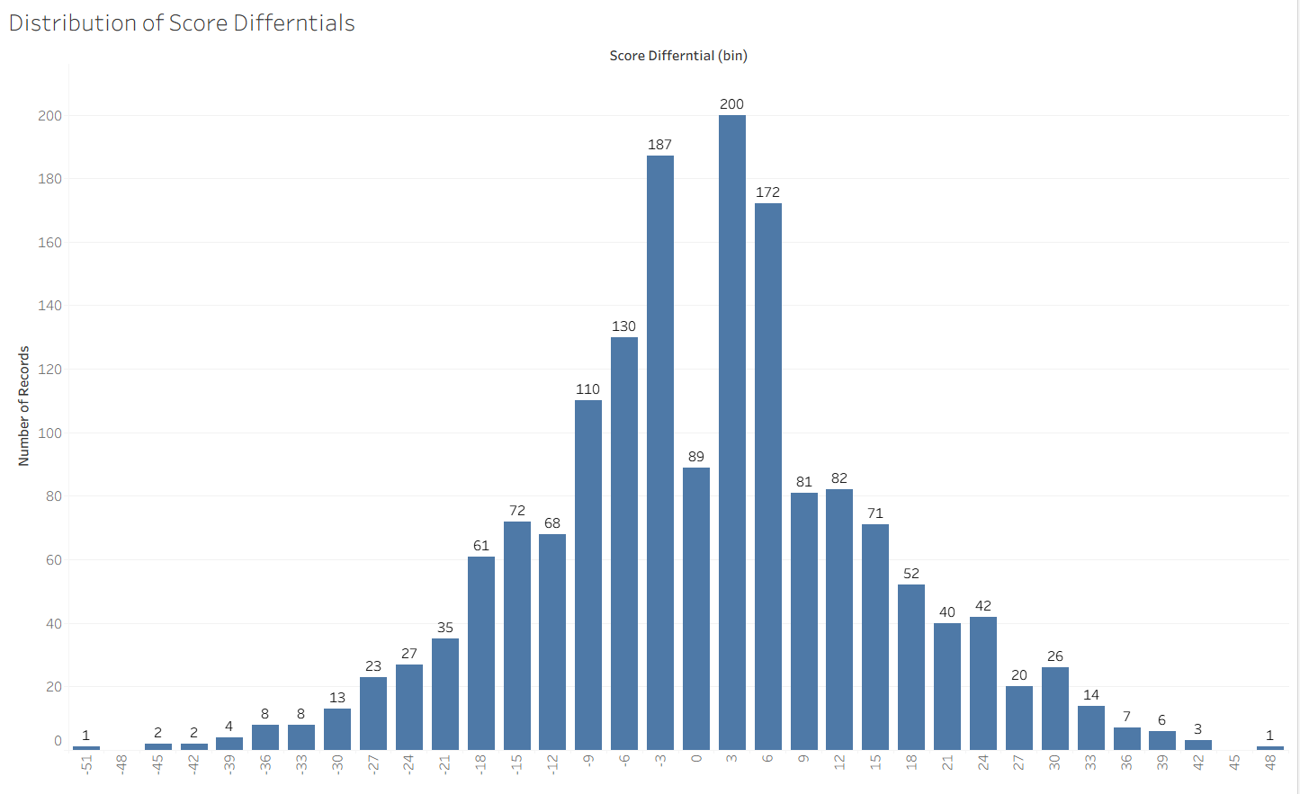
Distribution of Score Differentials
The distribution of score differentials is centered around small margins (roughly between -10 and +10), meaning most games are decided by relatively few points.
The tallest bars are on the slightly positive side of the scale, suggesting the team more often wins by a few points than loses by a few points.

Slide 13
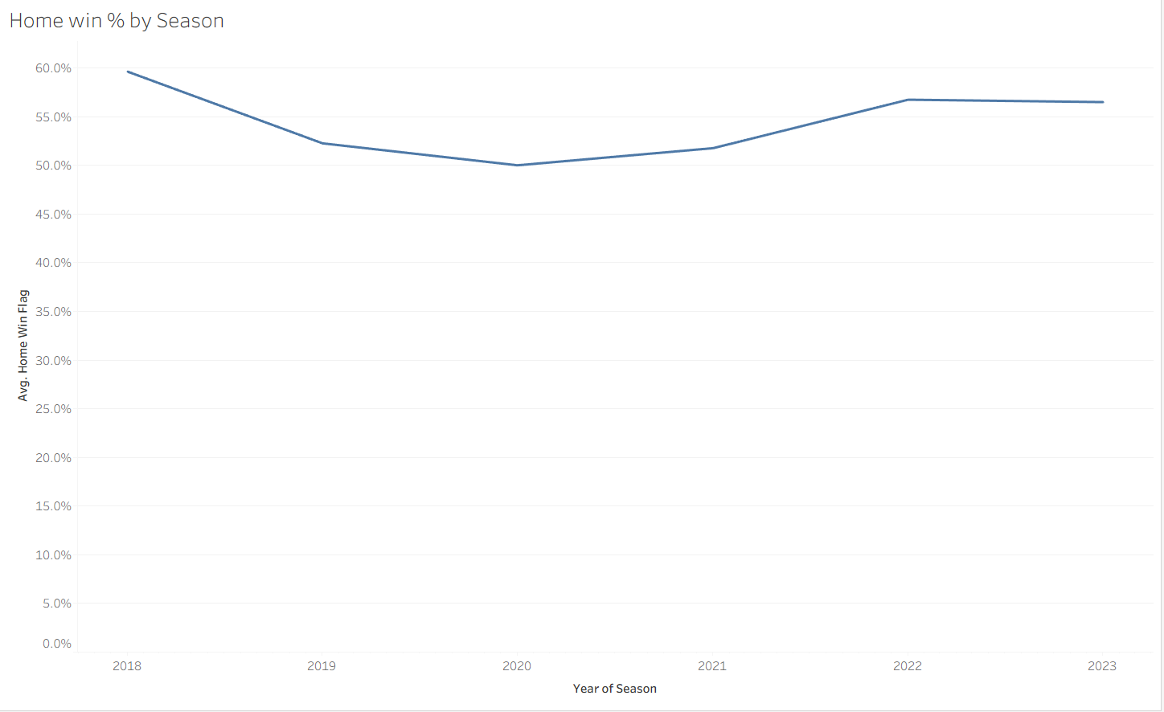
Home Win Percentage by Season
Home win percentage starts high around 2018, dips to its lowest point around the 2020 season, and then climbs back up, peaking again in 2022 before slightly leveling off in 2023.
In every season shown, the home win rate stays above 50%, indicating a consistent home-field advantage over the entire period.

Slide 14
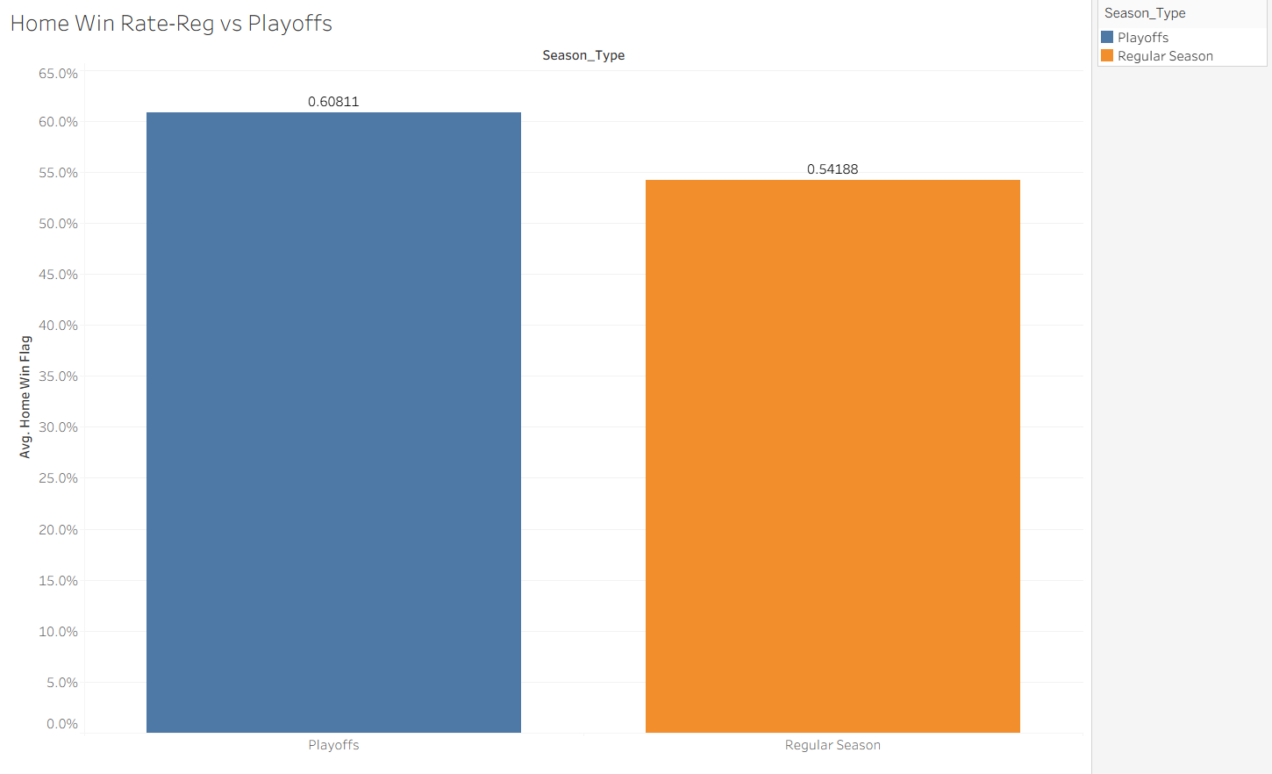
Regular Season Vs Playoffs Home Win Rate
The chart shows that the home win rate is higher in the playoffs (~60.8%) than in the regular season (~54.2%), indicating that home teams perform even better in postseason games.
In both the regular season and the playoffs, the home win rate is well above 50%, confirming a consistent home-field advantage.

Slide 15
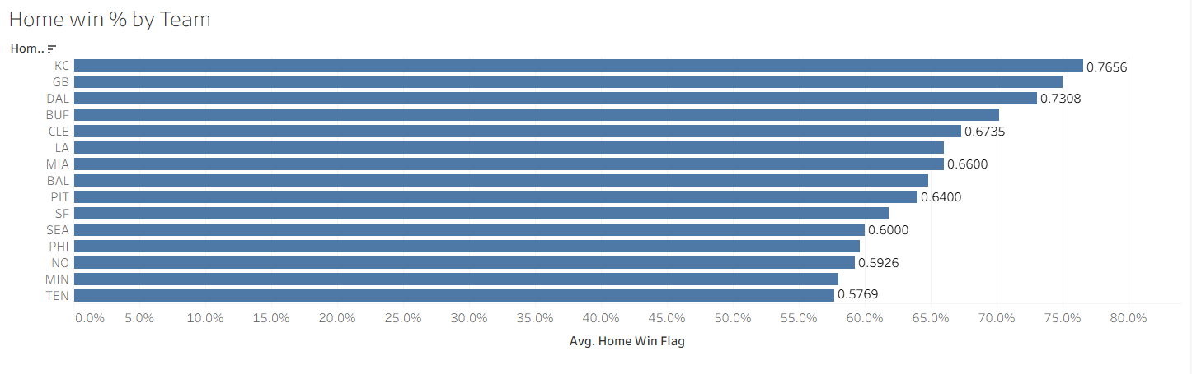
Top Teams by Home Win Percentage
This chart ranks teams by home win percentage, with Kansas City (KC) having the highest rate at about 76.6%, followed by Green Bay (GB) at roughly 73.1%.

Slide 16
Summary of Key Findings
Home teams win more than half of games and typically outscore away teams by a small margin.
Home-field advantage appears to be present in the modern NFL, though magnitude may vary by season.
Patterns around 2020 could be linked to COVID-19 and reduced stadium attendance.
Some teams show especially strong home records, while others are closer to neutral at home.

Slide 17
Implications for Teams & Coaches
Protecting home field is strategically important for reaching the playoffs.
Optimize travel and rest to reduce disadvantages in away games.
Invest in fan engagement and stadium atmosphere to amplify home-field advantage.

Slide 18

Implications for League & Sportsbooks
League should monitor long-term trends in home-field advantage.
Scheduling and rule changes can be evaluated using this type of analysis.
Sportsbooks and bettors should explicitly account for home-field effects in models.

Slide 19
Limitations & Future Directions
Analysis does not fully control for team strength, injuries, or travel distance.
Short time window (2018–present) may miss longer historical trends.
Future work: merge game outcomes with player stats, betting lines, attendance, and weather.

Slide 20
GitHub Project Structure
data/ – Original and cleaned datasets (e.g., nfl_mahomes_era_games.csv).
code/ – Scripts or notebooks for data cleaning and analysis.
figures/ – Exported charts used in the presentation and report.
report/ – Business case report summarizing objectives, methods, and findings.
README.md – Data description, download instructions, and reproduction steps.

Slide 21

Conclusion & Q&A
We used real NFL outcomes to quantify modern home-field advantage.
Evidence can inform decisions for teams, the league, and analytics roles.
Next steps: refine models, add more covariates, and extend the time horizon.
Thank you! Questions?

